Slide 1
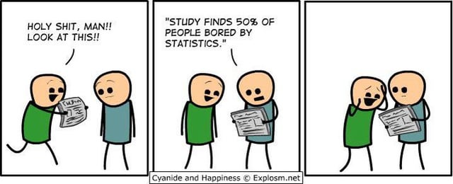
HRA Review

Slide 2
Topics to know
Hypotheses & variable types
Sampling, reliability, validity
Type 1 & 2 errors
Confidence intervals
Chi square
Correlation
T-tests
ANOVA
Theory
Data assumptions
When do you use these tests?

Slide 3
Variable types:
What types of Variables are there?
Categorical
        Nominal
        Ordinal
Continuous
        Interval
        Ratio

Slide 4
Identify what we are measuring
We want people to be more active. In order to accomplish this, we first need a baseline measurement. We need to record how many steps the students at HMSM take on average.
Ratio
µ
Pineapple on pizza is very divisive. We’d like to find out just how many people actually like pineapple on pizza.
Nominal
π
You want to monitor just how long people spend on an app.
Ratio
µ
An employment agency wants to find out the level of education of their successfully placed candidates.
Ordinal
π

Slide 5

Making statistical hypotheses
Oh no, I’m a manager and have to make decisions.
A
B

Slide 6
Making statistical hypotheses
We are always choosing between two options.
  The null hypothesis
  The alternate hypothesis
A
B

Slide 7

Making statistical hypotheses
The alternate hypothesis (H₁ or H_{a})
This is the reason you are doing research. It’s what you think, what you assume, what motivates you to think that something is perhaps different.

Slide 8
Making statistical hypotheses
The null hypothesis (H₁ or H_{a})
This is always the opposite of the alternate hypothesis. All outcomes must be accounted for in the hypotheses pair.
< with ≥
≤ with >
= with ≠

Slide 9
Make statistical hypotheses
We want people to be more active. Students currently walk on average 8000 steps a day. A step competition is started to see if daily steps will increase.
H0: µ ≤ 8000
H1: µ > 8000
It is believed that 30% of people like pineapple on pizza. I think this is wrong. I buy pizza and see how much of each pizza gets eaten.
H0: π = 0.3
H1: π ≠ 0.3
Students spend an average of 6 hours a day on TikTok. We wonder if that decreases during exam week.
H0: µ ≥ 6
H1: µ < 6
An employment agency believes more of their successfully placed candidates have a higher education.
H0: π degree ≤ π no degree
H1: π degree > π no degree

Slide 10
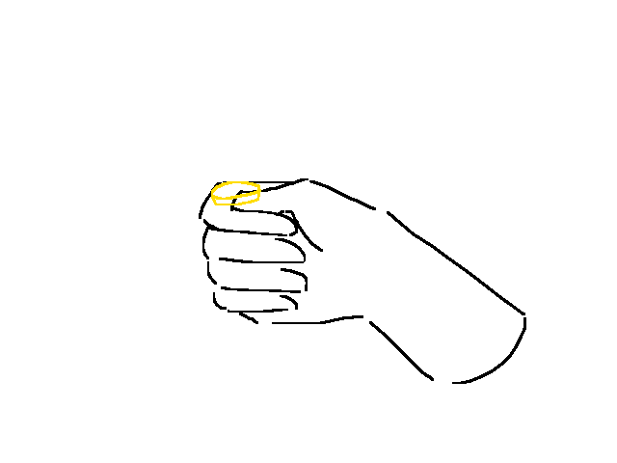
So now you have two options to choose from
How do I know which one is correct?
A
B
Use a statistical test. If p < 0.05
you are 95% certain in choosing H1
Flip a coin? P = 0.5
You have a 50/50 chance of being right, with
either hypothesis.
OR

Slide 11
So you want to use a statistical test.... Good choice
First, we’re going to need some data. We collect this through sampling.
Probability sampling
    Simple Random sampling
    Systematic sampling
    Stratified sampling
    Cluster sampling
Non-Probability sampling
    Snowball sampling
    Convenience sampling
    Quota sampling
    Self-selection sampling

Slide 12
Choose/ Name the sampling method
A student council wants to survey students about improvements needed on campus. They need responses from students in all year levels
Stratified sampling
A gym wants to study the exercise habits of its members but doesn’t have a list of all members. Staff members simply approach people who happen to be using the gym during certain hours.
    Convenience sampling
A student is researching a rare hobby, like scuba diving. Members of the scuba diving community are hard to find, so each person surveyed recommends others.
    Snowball sampling
A company wants to measure job satisfaction among employees from multiple branches in different cities. It’s only feasible to survey a few branches.
Cluster sampling

Slide 13

Sampling = data!
And data means we can do analysis!
But we want to do a RELIABLE AND VALID analysis.
So let’s make sure what we’re doing is good, not garbage

Slide 14
Valid means true and accurate
Types of Validity
Face Validity
Content Validity
Criterion Validity
Construct Validity
Internal Validity
External Validity
Does it appear to do what it’s supposed to (also can be an opinion from an expert)
Does it cover everything to measure the topic fully?
Is your tool accurate and/or calibrated
Does your tool actually measure what it’s supposed to?
Were there any biases? Confounding factors?
Do the results apply to situations outside of this particular study

Slide 15


Slide 16
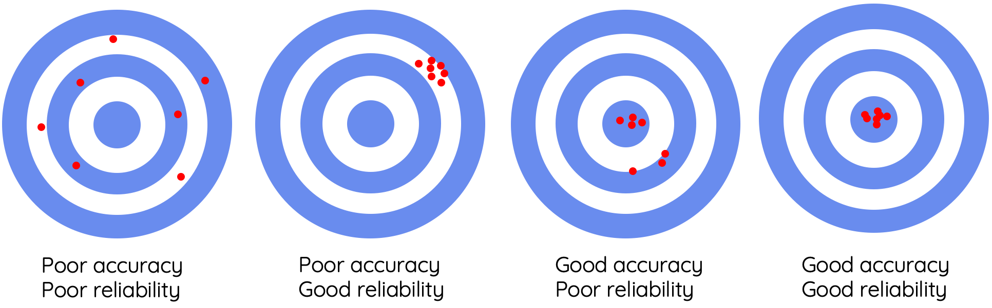
Reliability: Is something consistent?

Slide 17
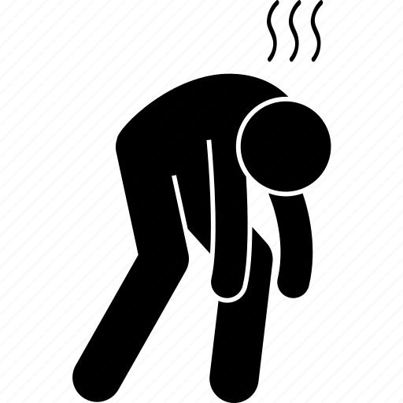
Can I do a statistical test already?
Yes! You have valid data and some hypotheses! Let’s choose a statistical test!

Slide 18
The test you choose depends on your data type.
Chi²
  2 categorical variables
Correlation
  2 continuous variable
T-test
  1 categorical variable – 2 levels
  1 continuous variable
ANOVA
  1 categorical variable – 3 or more levels
  1 continuous variable
Is there a relationship between the variables?
Is there a difference in the means when comparing groups?

Slide 19
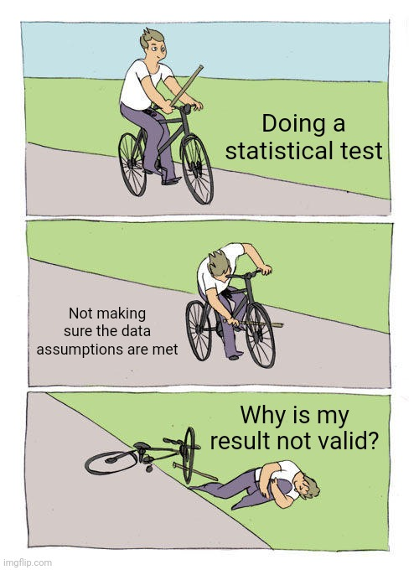
DATA
ASSUMPTIONS

Slide 20
What are the assumptions that need to be met for each test?
Chi²
  Expected count of >5
Correlation
  Linear
  No major outliers
T-test
  Homogeneity of Variance (Levene’s test)
  Normal distribution
ANOVA
  Homogeneity of Variance (Levene’s test)

Slide 21
Chi Squared test – calculate expected counts
Contingency Tables
 |  | age group
music genre |  | under 15 |  | 15-30 |  | 30-50 |  | >50 |  | Total
rock |  | 40 |  | 50 |  | 40 |  | 80 |  | 210
metal |  | 80 |  | 50 |  | 20 |  | 40 |  | 190
pop |  | 120 |  | 50 |  | 12 |  | 30 |  | 212
country |  | 20 |  | 30 |  | 10 |  | 30 |  | 90
rap |  | 40 |  | 20 |  | 5 |  | 10 |  | 75
house |  | 60 |  | 60 |  | 5 |  | 20 |  | 145
Total |  | 360 |  | 260 |  | 92 |  | 210 |  | 922
*
(row total X column total) / grand total
(75 x 92) / 922 = 7.4

Slide 22
Chi Squared test – is there a relationship?
χ² Tests
 |  | Value |  | df |  | p
χ² |  | 132 |  | 15 |  | < .001
N |  | 922
Chi Squared test – How strong is that relationship?
Nominal
 |  | Value
Phi-coefficient |  | NaN
Cramer's V |  | 0.219

Slide 23
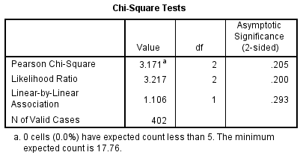
Chi Squared test – is there a relationship?

Slide 24
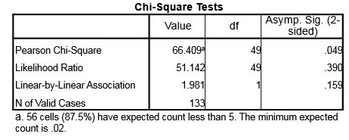
Chi Squared test – is there a relationship?
Not valid

Slide 25
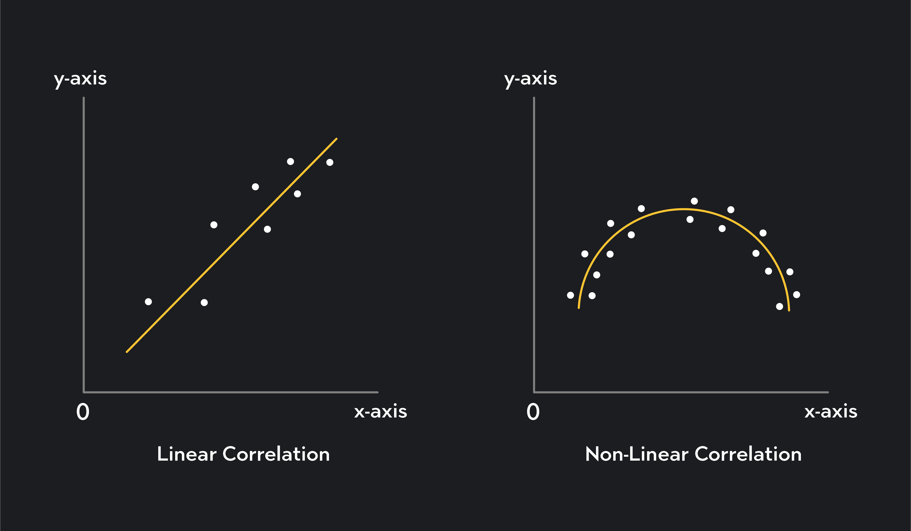
Pearsons Correlation

Slide 26
Correlation output – Is there a relationship?
Correlation Matrix
 |  |  |  | Blue light exposure |  | Sleep Quality
Blue light exposure |  | Pearson's r |  | —
 |  | p-value |  | —
Sleep Quality |  | Pearson's r |  | -0.928 |  | —
 |  | p-value |  | < .001 |  | —
Correlation output – How strong is the relationship?

Slide 27
Pearsons R: The correlation coefficient
-1.0
1.0
Perfect correlation
Strong
Weak
0
No correlation

Slide 28
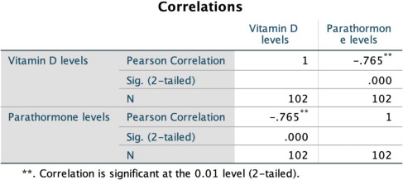
Is there a relationship between these variables?
Is it strong or weak?
Positive or negative?

Slide 29
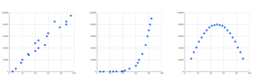
Which data are appropriate for a Pearson’s correlation
A.
B.
C.

Slide 30
T-tests
What are the data assumptions?
Why?
Normal distribution
Homogeneity of Variance (Levene’s test)

Slide 31
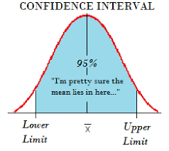
Normal distribution = confidence interval
What is a confidence interval?
A range of numbers in which the true value will fall with a high degree of certainty.
Critical value
Critical value

Slide 32
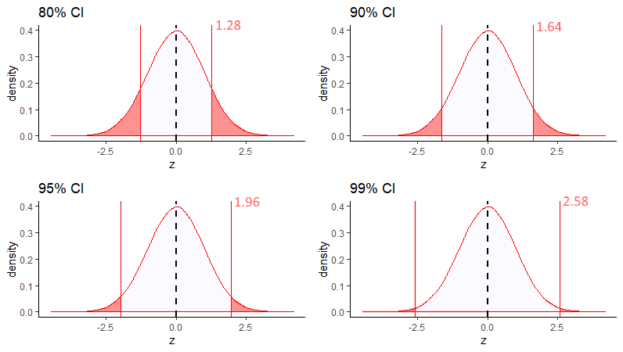
What factors affect a confidence interval?
Sample size
As sample size increases, our confidence interval gets narrower
Confidence level
As confidence level gets higher (99 vs 95), our interval gets wider

Slide 33
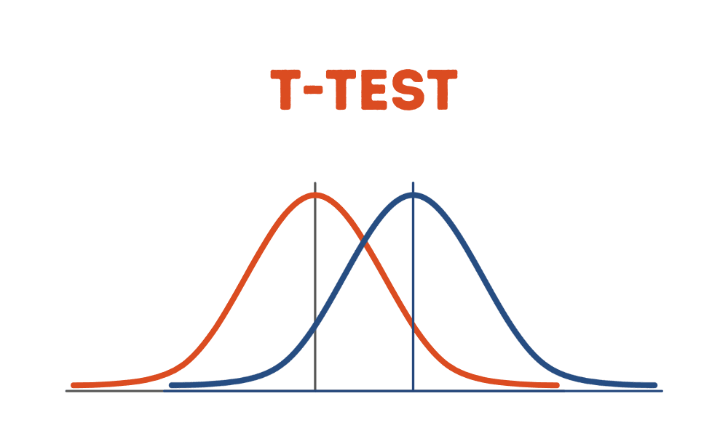

Slide 34
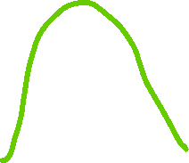



Homogeneity of variance (Levene’s test)
H1
H0
Significant p value
Variance within the group

Slide 35
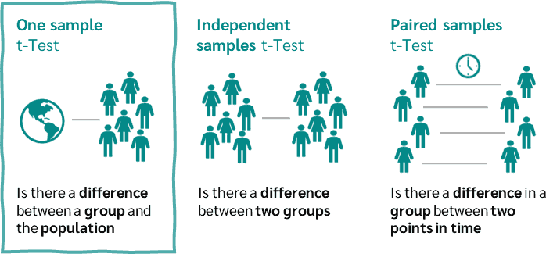
What are the three types of t-tests?

Slide 36
A hotel manager wants to compare the average guest satisfaction score in their hotel against a known industry standard of 8.5. They collect satisfaction scores from a sample of recent guests. Which test is appropriate? a) One-sample t-test b) Independent t-test c) Paired t-test d) Mann-Whitney U test

Slide 37
Two different hotels want to compare their average ratings on cleanliness. The ratings are collected independently from guests of each hotel. Which test should be used? a) One-sample t-test b) Independent t-test c) Paired t-test d) Mann-Whitney U test

Slide 38
A researcher is comparing the time it takes two groups of employees, one in customer service and one in housekeeping, to complete a task. The data for each group is not normally distributed. Which test should they choose? a) One-sample t-test b) Independent t-test c) Paired t-test d) Mann-Whitney U test

Slide 39
A researcher is comparing the time it takes two groups of employees, one in customer service and one in housekeeping, to complete a task. Levene’s test results in a p-value of 0.049. Which test should they choose? a) One-sample t-test b) Independent t-test c) Paired t-test d) Mann-Whitney U test

Slide 40
A researcher wants to compare the average guest satisfaction scores across three different hotels in a chain (Hotel A, Hotel B, and Hotel C) to see if there is a significant difference between them. Which test should they use? a) One-sample t-test b) Independent t-test c) Paired t-test d) Mann-Whitney U test
ANOVA

Slide 41
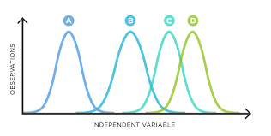
ANOVA
What are the null and alternate hypotheses with an ANOVA?
H0:
µ1 = µ2 = µ3 = µ4.....
µ1 ≠ µ2 ≠ µ3 ≠ µ4.....
H1:

Slide 42
Levene’s test tells us what to do.
Conclude H0
Insignificant p
Significant p-value
P < 0.05
Conclude H0
Insignificant p
ANOVA F-test
ANOVA Welch-test
Insignificant p
Significant p-value
P < 0.05
Significant p-value
P < 0.05
Post hoc
Bonferonni or tukey
Games-howell

Slide 43
What rules should be met to have a valid anova f-test result? a) You must only have 3 groups b) You must have homogeneity of variance
C) You must have only categorical data
You must have visulaized your data

Slide 44
What rules should be met to have a valid anova Welch-test result? a) You must only have 3 groups b) You must have homogeneity of variance
C) You must have a categorical variable (>2 levels) and a continuous variable d) You must have visualized your data

Slide 45
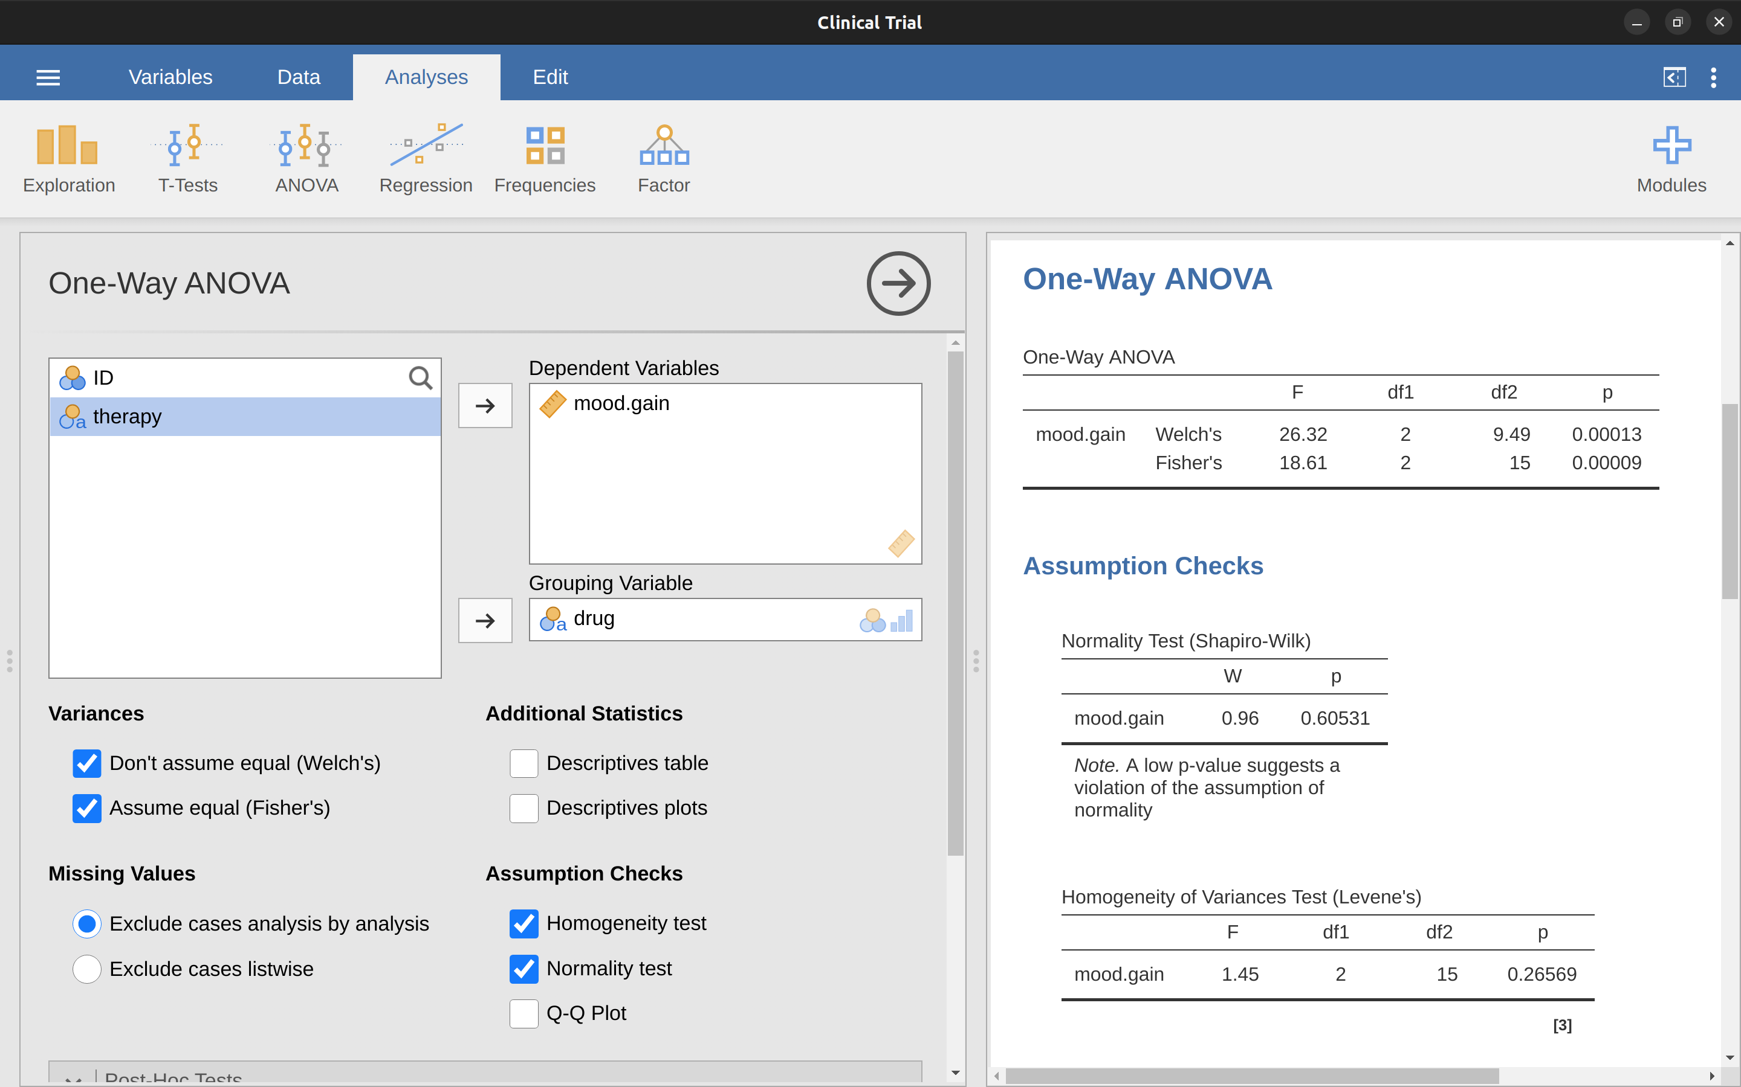

Based on these results, what following steps should be taken?
We report Fisher’s value, and follow up with a Bonferroni post-hoc
We report Welch’s value and follow up with a Games-Howell
We report Fisher’s value, and no post-hoc is needed
We report Welch’s value and follow up with a Bonferonni post-hoc

Slide 46
We’ve covered everything...except type 1 and 2 errors

Slide 47
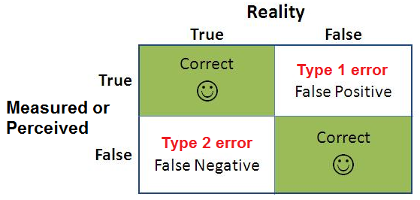

Slide 48
Significance level = Chance of type 1 error
P= 0.05
5% chance of concluding a false positive
P= 0.15
15% chance of concluding a false positive
P= 0.7
70% chance of concluding a false positive

Slide 49
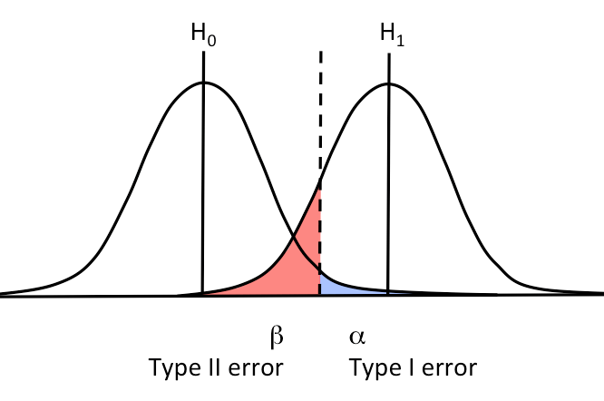

Slide 50
A hotel manager believes that offering a complimentary breakfast will increase guest satisfaction scores.
The null hypothesis is that the complimentary breakfast has no effect on satisfaction scores.
After implementing the breakfast, guest satisfaction scores are analyzed, and the manager concludes there was an increase in satisfaction scores, even though there was no real change.
What type of error has occurred?
Type 1

Slide 51
A judge releases a guilty person, having incorrectly concluded that they were innocent.
What type of error has occurred?
Type 2

Slide 52
